Slide 1


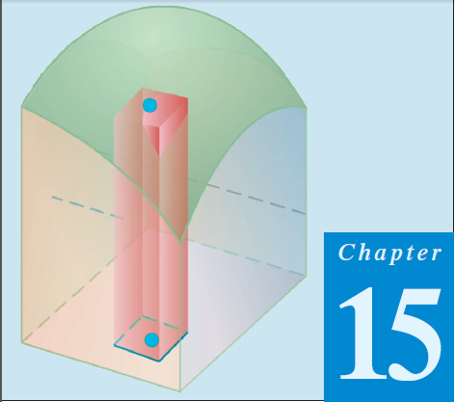
Thomas Calculus 11th
13
Changing Integral Variables
Samuel Lukas

Slide 2
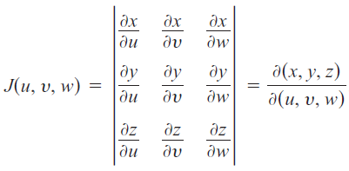
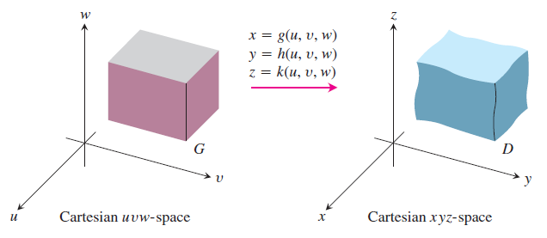

Substitutions in Triple Integrals

Slide 3

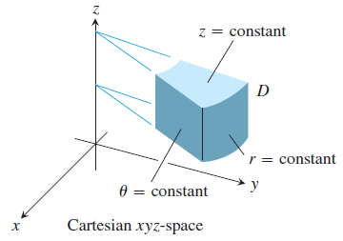
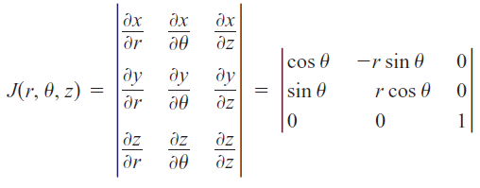



Slide 4
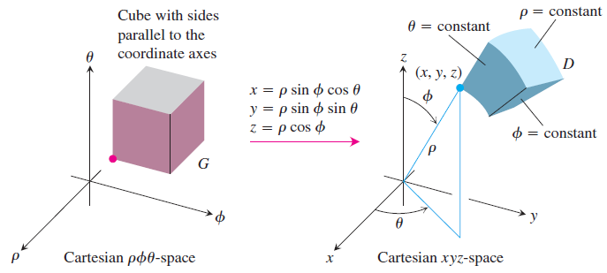

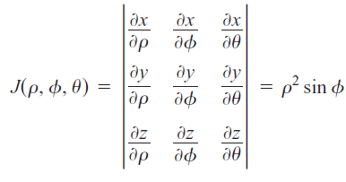

Slide 5

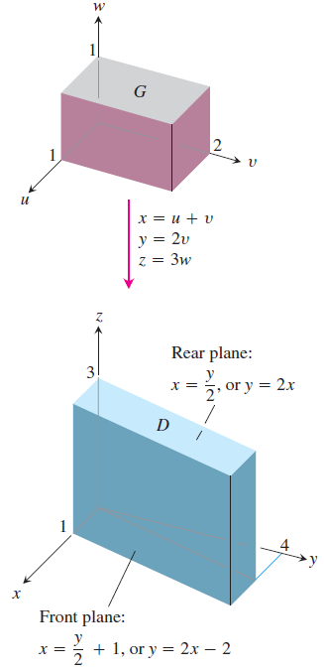







Evaluate :

Slide 6


Exercises
Evaluate the integrals
01.
02.
03.
04.
05.

